Slide 1
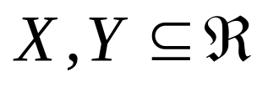
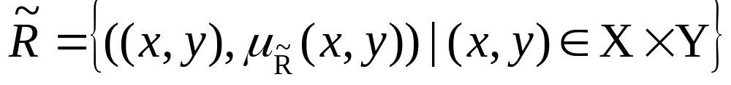
Fuzzy relations (contd.)
Are fuzzy subsets of X×Y (mappings from X→Y)
Definition :
let
R Is a fuzzy relation on X×Y

Slide 2

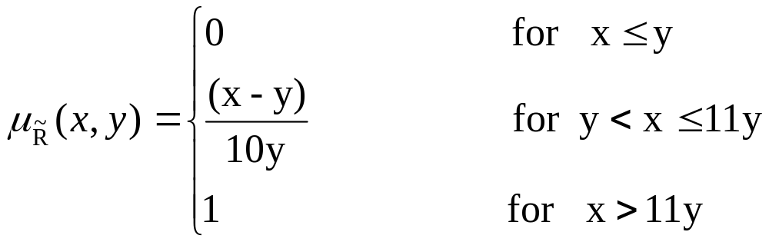
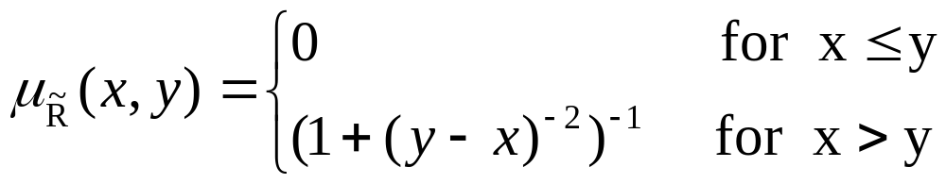
Fuzzy relations (contd.)
Example:
A fuzzy relation defined as: “x considerably larger than y”
MBF can be:
Or :

Slide 3
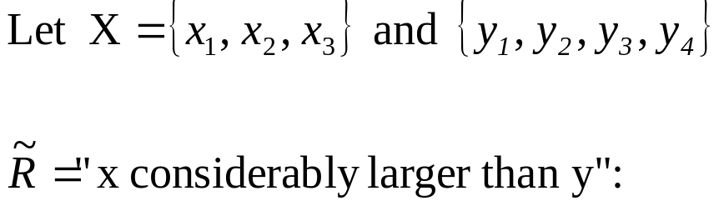

Fuzzy relations (contd.)
- For discrete universes, it can be defined by matrixes.
Example 1:
^{y}₁ ^{y}₂ ^{y}₃ ^{y}₄
^{x}₁
^{x}₂
^{x}₃
.8 | 1 | .1 | .7
0 | .8 | 0 | 0
.9 | 1 | .7 | .8
Example 2:
^{y}₁ ^{y}₂ ^{y}₃ ^{y}₄
^{x}₁
^{x}₂
^{x}₃
.4 | 0 | .9 | .6
.9 | .4 | .5 | .7
.3 | 0 | .8 | .5

Slide 4
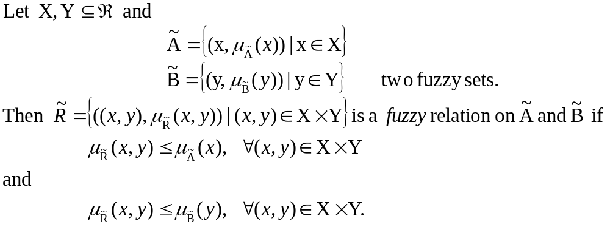
Fuzzy relations (contd.)
-Generalized definition:

Slide 5


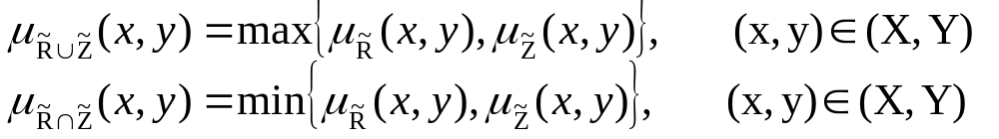
Fuzzy relations (contd.)
Using extension principle:
Let and be two fuzzy relations in the same product space.
The union/intersection of with is then defined by:

Slide 6
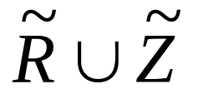
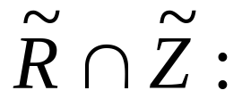
Fuzzy relations (contd.)
-Let consider again previous examples:
→“considerably larger”
→“very close to”
The union can be interpreted as “x considerably larger or very close to y”
^{y}₁ ^{y}₂ ^{y}₃ ^{y}₄
^{y}₁ ^{y}₂ ^{y}₃ ^{y}₄
  ^{x}₁
  ^{x}₂
  ^{x}₃
.8 | 1 | .9 | .7
.9 | .8 | .5 | .7
.9 | 1 | .8 | .8
  ^{x}₁
  ^{x}₂
  ^{x}₃
.4 | 0 | .1 | .6
0 | .4 | 0 | 0
.3 | 0 | .7 | .5

Slide 7
Composition of fuzzy relations
Max-min composition :
Max-prod composition:
Max-av composition:

Slide 8
Fuzzy Graphs
Definitions:
-Fuzzy graph
Fuzzy subgraph
Spanning graph
A path
Strength of a path
Length of a path
Cycle
μ-distance
μ-length
Connected nodes
Forest

Slide 9
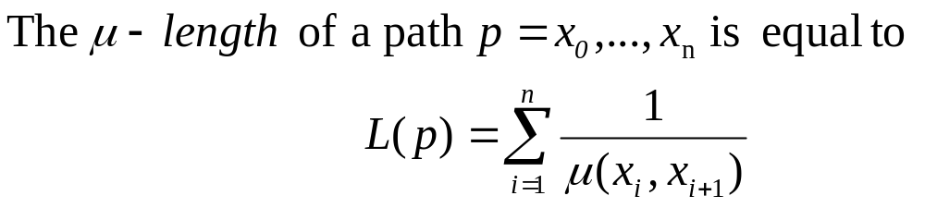
Fuzzy Graphs (cont.)
Definition:

